Slide 1

AN INTELLIGENT CROWD DENSITY MONITORING AND ALERT SYSTEM FOR SAFE PUBLIC GATHERINGS
FINAL REVIEW
Student Name:
V.Vigneshwaran 23619142
S.Udhayapradap 23619140
Guide Name:
Mrs.S.M.Sowmiya

Slide 2
Problem Statement
Existing crowd monitoring systems rely on manual surveillance or camera-only methods, which may produce inaccurate results and delayed responses.
There is a need for an intelligent real-time system that accurately detects overcrowding and generates early alerts to prevent crowd-related accidents.

Slide 3
Objectives:
Detect people in real time using YOLOv8.
Track individuals across video frames using ByteTrack.
Estimate crowd density and occupancy in specific zones.
Improve monitoring using sensor-assisted information.
Generate an automatic alert when the crowd exceeds a predefined safety threshold.
Provide a system suitable for places such as temples, railway stations, malls, stadiums, and festivals.

Slide 4
Literature Survey
Paper Name | Methodolgy | Algorithm | Advantages | Disadvantages
Dense-Stream YOLOv8n: A Lightweight Framework for Real-Time Crowd Monitoring in Smart Libraries | Uses a lightweight deep learning framework to detect, count, and monitor crowds in real time with optimized edge deployment. | YOLOv8n, DensityNet, Model Pruning, Knowledge Distillation | High accuracy, lightweight, real-time performance, suitable for edge devices | Limited to crowd monitoring; no sensor fusion or early prediction
ByteTrack: Multi-Object Tracking by Associating Every Detection Box | Associates detected objects across consecutive video frames to maintain consistent tracking IDs. | ByteTrack, Kalman Filter, IoU Matching | Accurate multi-object tracking with stable IDs | Cannot estimate crowd density or generate alerts
YOLO-Based Human Detection for Smart Video Surveillance at the Edge | Detects people from surveillance video frames using a real-time object detection model. | YOLOv8 | Fast and accurate real-time person detection | Cannot track people across multiple frames
CSRNet: Dilated Convolutional Neural Networks for Understanding the Highly Congested Scenes | Generates crowd density maps from images using deep convolutional neural networks for accurate crowd estimation. | Dilated Convolutional Neural Network (CSRNet) | High accuracy in dense crowd counting | Does not perform person tracking or real-time alerting
An Intelligent Crowd Density Monitoring and Alert System for Safe Public Gatherings | Uses IR sensors and IoT devices to count people and monitor crowd occupancy in real time. | IR Sensor, ESP8266 (NodeMCU), IoT | Low-cost, simple to implement, real-time occupancy monitoring | Limited to entry/exit counting; cannot visually analyze crowd behavior

Slide 5
Proposed System:
Detects people in real time using YOLOv8 and tracks them with ByteTrack.
Combines camera and IR/Laser sensor data through sensor fusion for reliable crowd counting.
Performs zone-wise occupancy monitoring with configurable safety thresholds.
Generates automatic alerts when crowd density exceeds safe limits.
Supports deployment in temples, festivals, railway stations, malls, and stadiums with a lightweight edge-based architecture.

Slide 6
System Architecture:
Video Acquisition
Frame Processing
Person Detection
Person Tracking
Monitoring Zone
Identification
Alert generation
If Threshold
exceeds
Threshold Checking
people counting
Continue
Monitring
if Threshold
normal

Slide 7
Flow diagram of process:
Camera Capture
YOLOv8n
Person Detection
ByteTrack
Tracking
Crowd Count
& Density
ESP32
Buzzer Alert
Fusion &
Threshold Decision
Laser Activity
Dashboard
Status

Slide 8
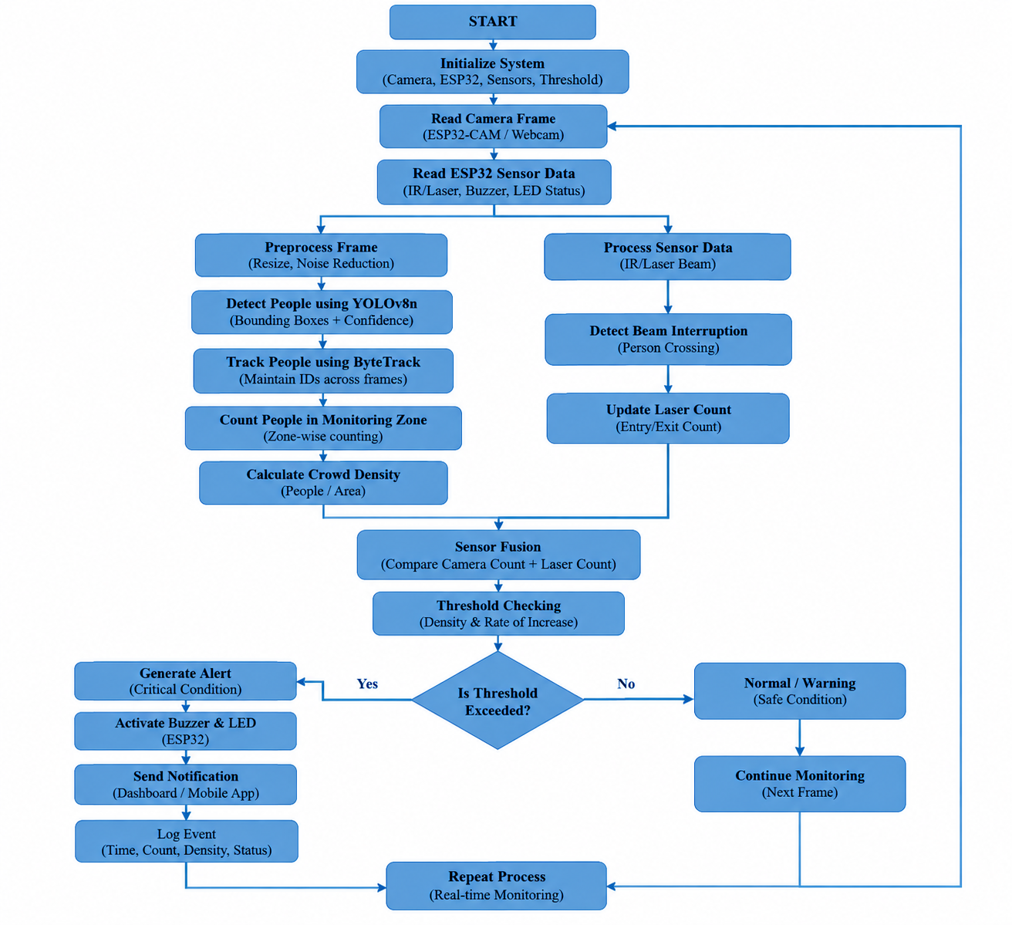
Flow Chart:

Slide 9
Module implementation progress:
Module | Description | Status
M1 Video Acquisition | Capture live video frames from CCTV / ESP32-CAM for crowd monitoring | Implemented
M2 AI Person Detection | Detect and localize people using YOLO-based object detection | Implemented
M3 Person Counting | Count detected people within the selected monitoring region | Implemented
M4 Crowd Density Analysis | Calculate crowd density and compare it with the safe occupancy threshold | Implemented
M5 AI Trend Analytics | Analyze the rate of crowd-density increase for early warning prediction | Implemented
M6 Risk Scoring | Classify crowd condition as Safe, Warning, or Critical based on density and trend | Implemented
M7 ESP32 IoT Alerts | Process laser–IR sensor input and activate the buzzer for physical alerts | Implemented
M8 Dashboard & Alerts | Display live detection, crowd count, density, risk level and alert status | Implemented

Slide 10
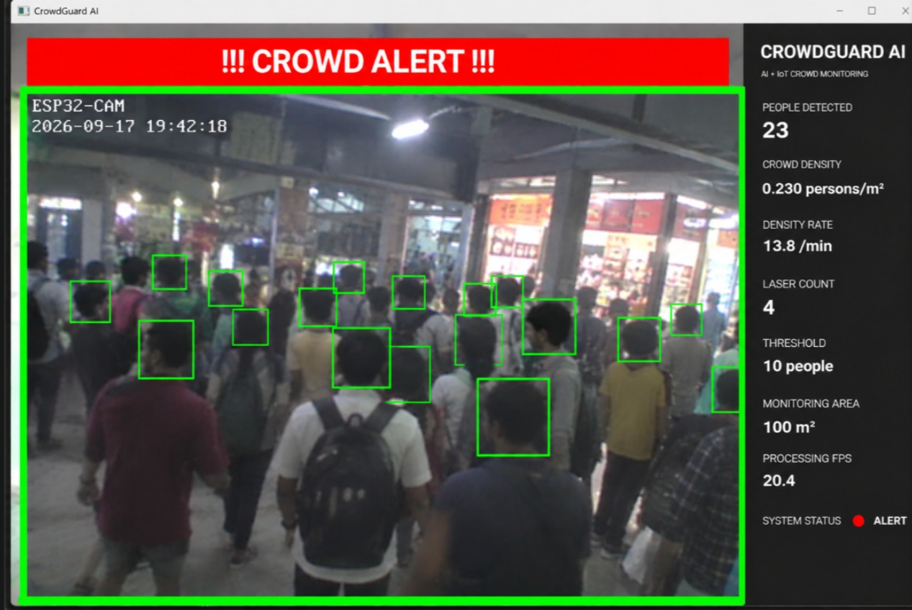
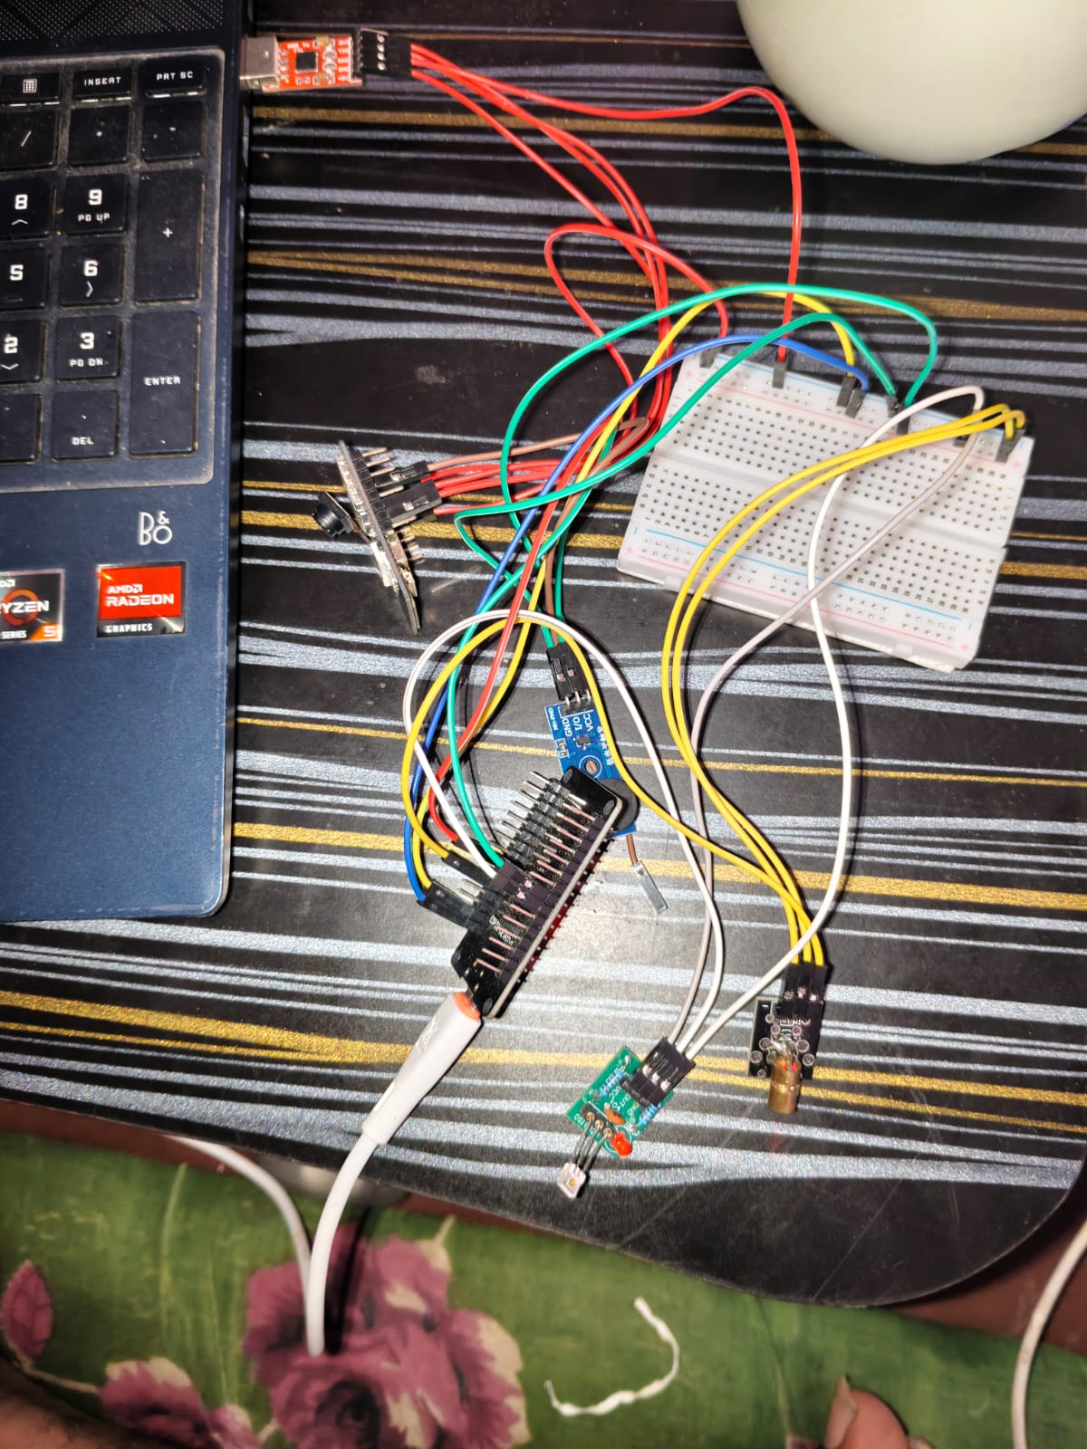
Implementation:

Slide 11
Hardware And Software:
• Laptop / PC
• ESP32-CAM
• ESP32
• IR / Laser Beam Sensor
• Buzzer
• LED
• Webcam (prototype)
• Breadboard & Jumper Wires
• Python 3.12
• OpenCV 5.0.0.93
• Ultralytics 8.4.104
• YOLOv8n
• ByteTrack
• NumPy 2.4.6
• PyTorch 2.13.0
• Torchvision 0.28.0
• VS Code
• Arduino IDE 2.x
• Windows 10/11

Slide 12
Result Accuracy:
People Detected: 1
Crowd Density: 0.010 persons/m²
Laser Detection Events: 4Alert
Detection: SuccessfulBuzzer
Response: SuccessfulCritical
Alert Response: SuccessfulProcessing
FPS: ~18–25 FPS in the demonstrated runClassroom
Area: 100 m²Test Threshold: 1 person
Sensor Fusion: Camera + Laser successfully integrated
Tracking: ByteTrack enabled
Detection Success: 100% (1 out of 1 person detected in the demonstrated test case)
Overall Functional Test: Successful

Slide 13
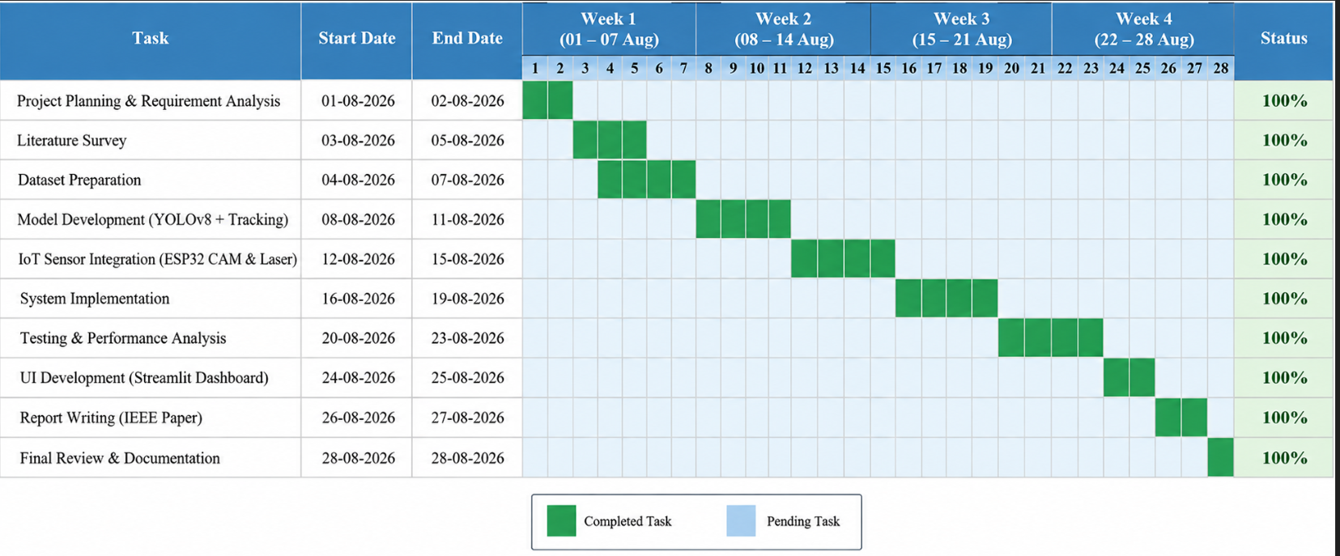
Gantt Chart:

Slide 14
Challenges faced:
Person detection accuracy under different lighting and camera angles.
Overlapping people and occlusion causing missed or incorrect detections.
Setting appropriate occupancy thresholds for different locations.
Real-time processing while maintaining fast detection and response.
Unstable IR sensor readings during initial ESP32 and laser–IR integration.
Laser and IR alignment to maintain reliable beam detection.
ESP32–software communication during IoT integration.
Reducing false alerts caused by temporary detection or sensor fluctuations.
Early-warning prediction based on the rate of increase in crowd density.
Integration of AI, IoT, and dashboard components into one complete system.

Slide 15
Testing progress:
Testing Stage | Testing Activity | Implementation
Acquire | Collect video/input data from the monitoring environment | Capture CCTV / ESP32-CAM frames containing different crowd levels
Validate | Verify detection, counting and sensor inputs | Validate person detection, bounding boxes, person count, laser–IR readings and remove invalid/noisy readings
Prepare | Preprocess and organize the input data | Resize video frames, define monitoring region/ROI and normalize inputs for AI processing
Train / Validate / Test | Divide data for model development and evaluation | Use training, validation and test data to evaluate the crowd-detection model
Evaluate | Measure model and system performance | Evaluate Accuracy, Precision, Recall, F1-Score, detection performance and alert response time

Slide 16
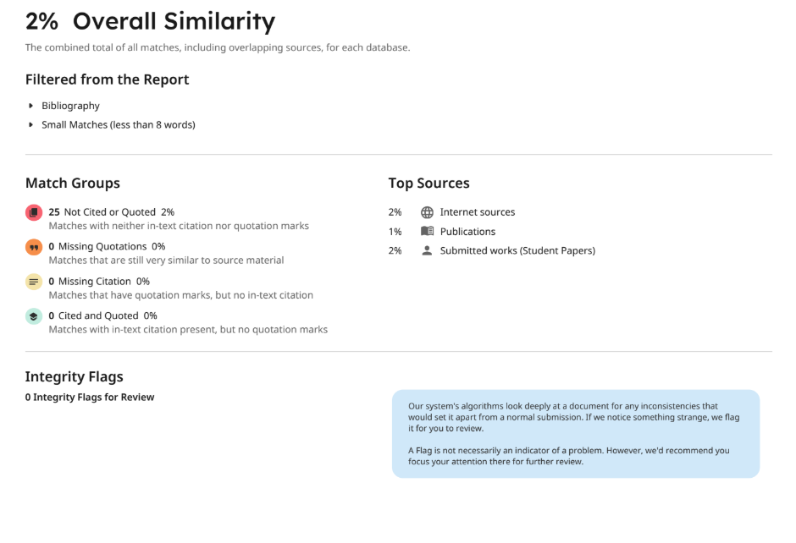
Plague report:

Slide 17
Reference:
[1] Z. Chen, X. Xie, T. Qiu, and L. Yao, “Dense-Stream YOLOv8n: A Lightweight Framework for Real-Time Crowd Monitoring in Smart Libraries,” Scientific Reports, vol. 15, 11618, 2025.
[2] Y. Zhang, P. Sun, Y. Jiang, D. Yu, F. Weng, Z. Yuan, P. Luo, W. Liu, and X. Wang, “ByteTrack: Multi-Object Tracking by Associating Every Detection Box,” European Conference on Computer Vision (ECCV), 2022.
[3] Y. Li, X. Zhang, and D. Chen, “CSRNet: Dilated Convolutional Neural Networks for Understanding the Highly Congested Scenes,” Proc. IEEE/CVF Conference on Computer Vision and Pattern Recognition (CVPR), pp. 1091–1100, 2018.
[4] H. H. Nguyen, V. T. Bui, T. N. Ta, H. M. Pham, N. C. Nguyen, and D. M. Nguyen, “YOLO Based Real-Time Human Detection for Smart Video Surveillance at the Edge.”
[5] J. Reddy et al., “Crowd Control and Monitoring using Deep Learning,” 2024 Second International Conference on Networks, Multimedia and Information Technology (NMITCON), 2024.
[6] CrowdGuard AI Project Material, “An Intelligent Crowd Density Monitoring and Alert System for Safe Public Gatherings,” Department of Artificial Intelligence and Machine Learning.

Slide 18
Thank you

